Slide 1



Center Surround Research Update
Ian Cone
Shouval Lab
10/30/20

Slide 2
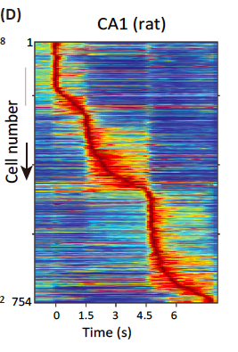
Purpose of Hippocampus?
“The hippocampus and its allied structures have been suggested to ‘encode’ a spatial map and, more recently, to ‘represent’ time. These theories lead to the postulates of place cells in the hippocampus, grid cells in the entorhinal cortex, and time cells in both structures.” (Buzsaki and Tingley 2018)
Or are these subsets of a much larger computational umbrella?

Slide 3
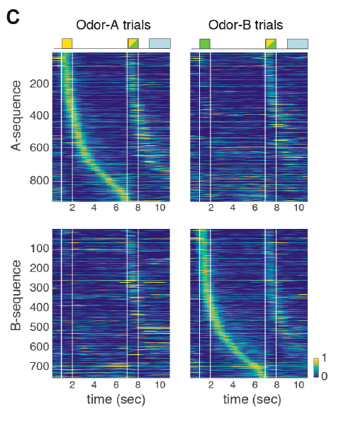
Hippocampal Encoding Scheme
Experiments suggest that characteristic cells in hippocampus (particularly CA1) respond to multiple contexts
ex: “place” cell that only fires in a certain place, while the animal is traveling a certain direction
Another ex: “time” cells which only fire at a particular time, if preceded by presentation a particular odor

Slide 4
Hippocampal Encoding Scheme
Experiments suggest that characteristic cells in hippocampus (particularly CA1) respond to multiple contexts
ex: “place” cell that only fires in a certain place, while the animal is traveling a certain direction
Another ex: “time” cells which only fire at a particular time, if preceded by presentation a particular odor

Slide 5
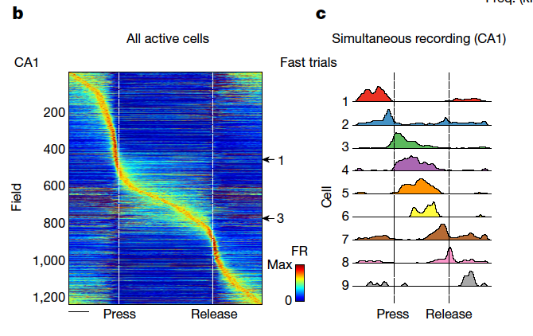
Hippocampal Encoding Scheme
Here, responsive cells are formed that respond discretely to different sound frequencies (via a press and release of a joystick along a continuous frequency axis).
“Neurons involved in this representation overlapped with the known spatial cell types in the circuit, such as place cells and grid cells.” (Arnov, Nevers, and Tank 2017)

Slide 6
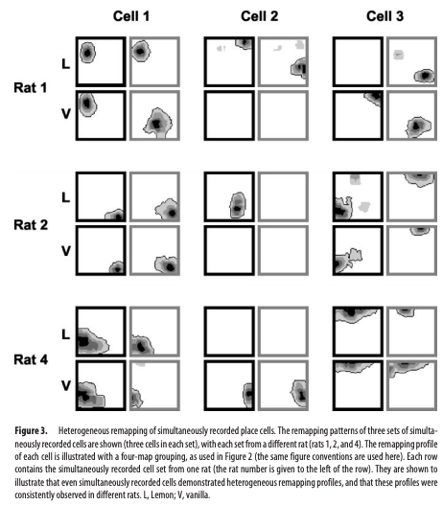
Hippocampal Encoding Scheme
Here, ”place cells” are measured across 4 different contexts (two possible odors, two possible tones of light) and show significant variation between contexts.
“Hippocampal place cells show spatially localized activity that can be modulated by both geometric information (e.g., the distances and directions of features in the environment) and nongeometric information (e.g., colors, odors, and possibly behaviors).” (Anderson and Jeffery 2003)

Slide 7
Purpose of Hippocampus?
Second hypothesis: Hippocampal CA3 takes inputs and creates spatiotemporal sequences unique to those inputs. These sequences are inputs to CA1.
In CA1, there are no “place cells” or “time cells”, strictly as such. Instead, a general class of “responsive cells” learns to map behaviorally relevant variables, through some sort of reward or instructive signal that co-occurs with a part of the CA3 sequence.

Slide 8
Some examples using Traditional and New Methods

Slide 9
Magee example
Animal is running along track, and at location x_0 receives a plateau potential in CA1 output cell
CA3 inputs themselves are explicitly place cells
Learning rule strengthens synapses with a presynaptic place field active during the plateau potential, and depresses others

Slide 10
Magee ODOR example
Animal receives one of two odor puffs immediately prior to running. During running, at location x_0 a plateau potential is induced in CA1
CA3 receives odor and position inputs and creates spatiotemporal outputs unique to the context & history
Learning rule strengthens synapses with presynaptic activity during the plateau potential
CA1 output fires at x_0, but only after the trained odor presentation

Slide 11
Magee ODOR example
Animal receives one of two odor puffs immediately prior to running. During running, at location x_0 a plateau potential is induced in CA1
CA3 receives odor and position inputs and creates spatiotemporal outputs unique to the context & history
Learning rule strengthens synapses with presynaptic activity during the plateau potential
CA1 output fires at x_0, but only after the trained odor presentation

Slide 12
The General example: MAGEE + Odor
Preceding an animal’s lap upon the track, it is puffed/not puffed with a particular odor
An artificial plateau potential is induced at a certain location on the track, for only one of the odors!
The result is a “place + smell” cell, which behaves like a place field, but only following the trained odor presentation.

Slide 13
The General example: T-Maze
Central pattern generator is given
Inputs can be visual/auditory/olfactory stimuli, place, time, heading, velocity, etc.

Slide 14
The General example
What if instead, you had a central pattern generator that would create a unique, robust, history dependent spatiotemporal trajectory for any given combination/sequence of inputs
Inputs can be visual/auditory/olfactory stimuli, place, time, heading, velocity, etc.

Slide 15
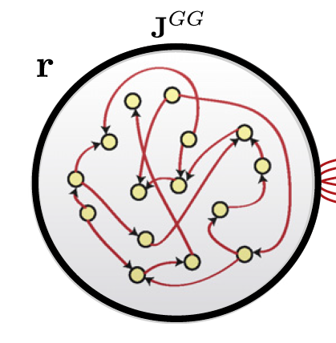
How to create Effective CPG
Liquid state machines are often the go to tool for generation of complex and unique spatio-temporal signals for any given input
However, a) their internal states are not robust to noise, and b) the learning rules used (backprop) are biologically unrealistic.

Slide 16
How to create Effective CPG
Liquid state machines are often the go to tool for generation of complex and unique spatio-temporal signals for any given input
However, a) their internal states are not robust to noise, and b) the learning rules used (backprop) are biologically unrealistic.

Slide 17
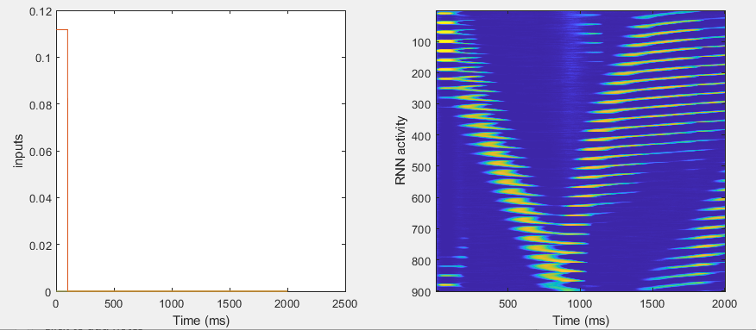
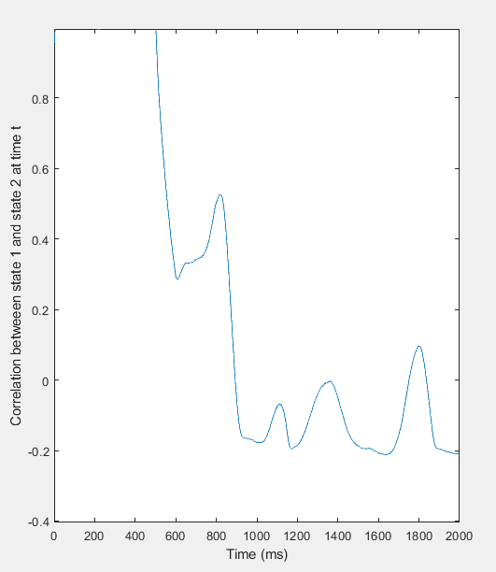
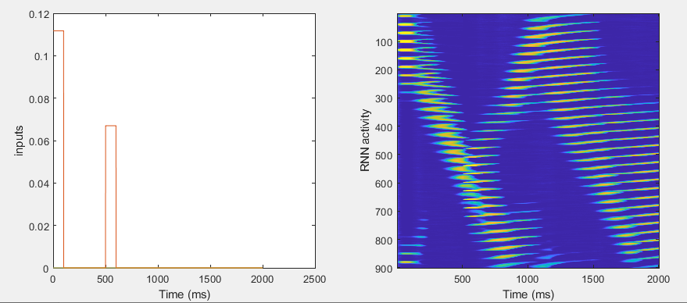
A
A-B

Slide 18
A
A-B

Slide 19
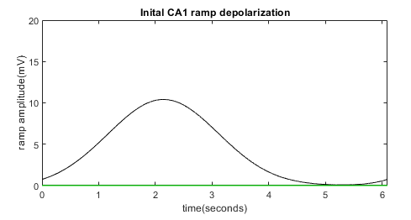

PostSynaptic Voltage

Slide 20
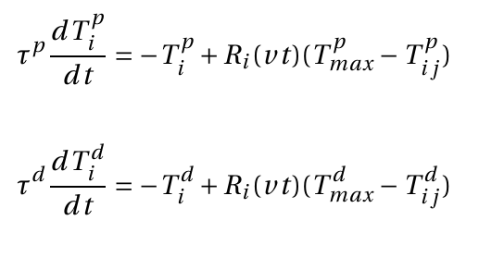
Presynaptic, weight-dependent traces
LTP and LTD associated traces are activated by presynaptic activity and decay in its absence

Slide 21
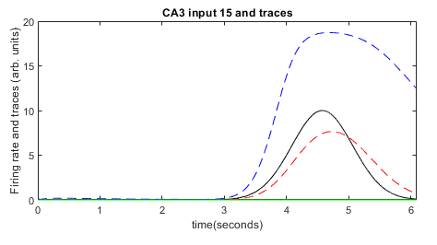
Presynaptic, weight-dependent traces

Slide 22
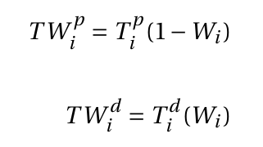

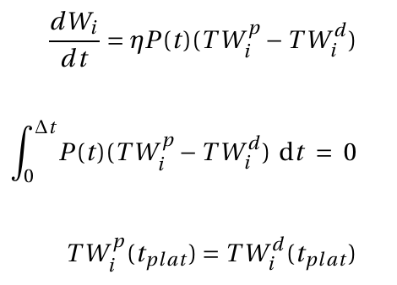
Instructive Signal and Weight updates
Weight modified versions TW favor LTD as weights are large and LTP as weights are small
“Instructive signal” from plateau potential acts as reward
Weights are updated in the presence of the instructive signal as LTP-LTD (both weight modified)

Slide 23
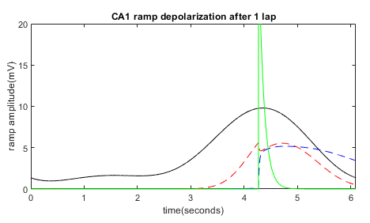
Instructive Signal and Weight updates

Slide 24
Fixed Points
(if P(t) is a delta)

Slide 25
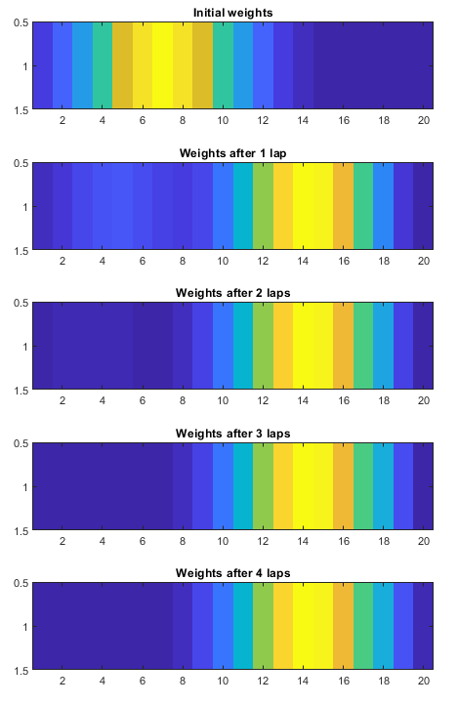
Fixed Points

Slide 26
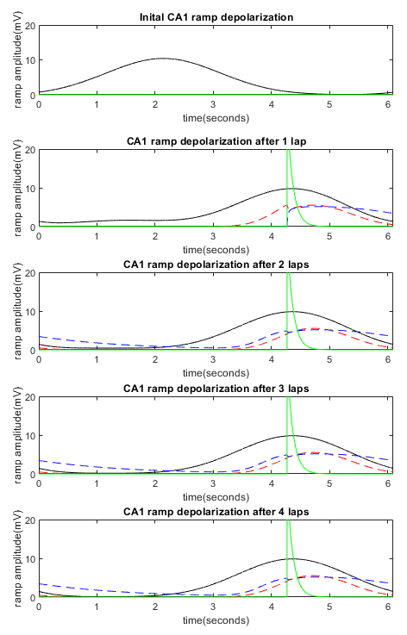
Fixed Points

Slide 27
Fixed Points
Fixed point of each synapse is independent (since no postsynaptic component of learning)
Learning does not change presynaptic firing, so shape of traces does not change (only magnitude)

Slide 28
Fixed Points
CA3 input and traces

Slide 29
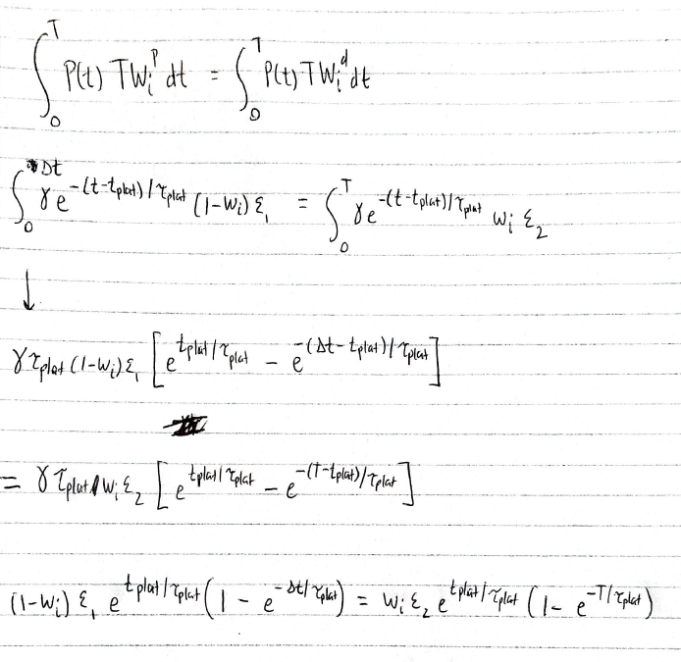
Fixed Points

Slide 30
Fixed Points
CA3 input and traces

